Slide 1

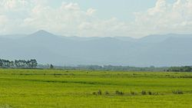
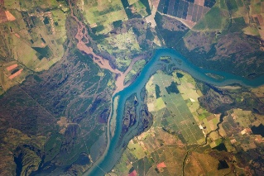





Impacts of large-scale soil moisture anomalies on regional hydroclimate in southeastern South America
Carolina A. Bieri
University of Illinois at Urbana-Champaign
Urbana, IL
Francina Dominguez
University of Illinois at Urbana-Champaign
Urbana, IL
David M. Lawrence
National Center for Atmospheric Research
Boulder, CO
Agriculture
River systems
NASA
Human populations
AGU Fall Meeting 2019
December 13, 2019
Notes:
Hi everyone! This is a culmination of the work I’ve done as part of my master’s project. This research focuses on southeastern South America and specifically the effect of large-scale soil moisture anomalies on the atmosphere and precipitation. Before I continue, I want to acknowledge contributors to this work, including my advisor Francina, of course, and David Lawrence from NCAR.

Slide 2
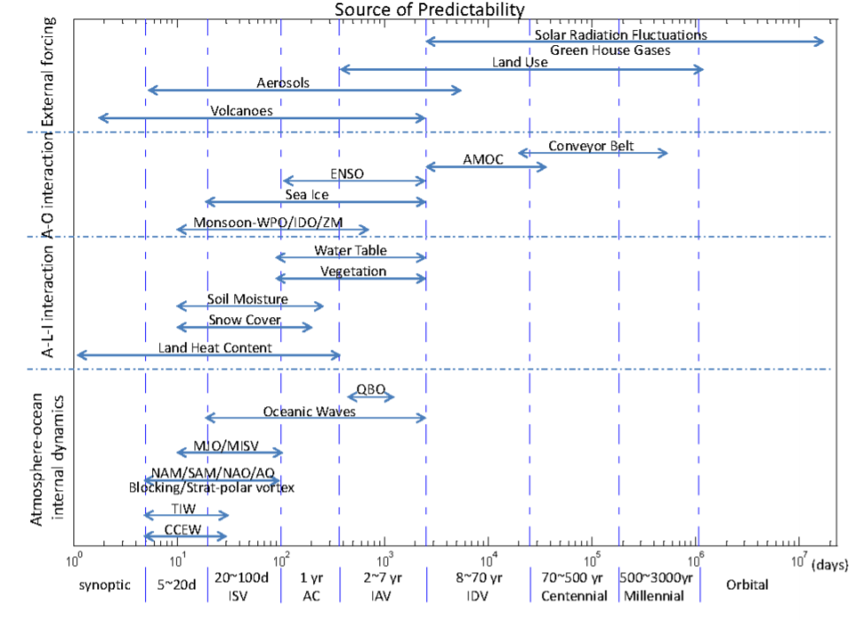
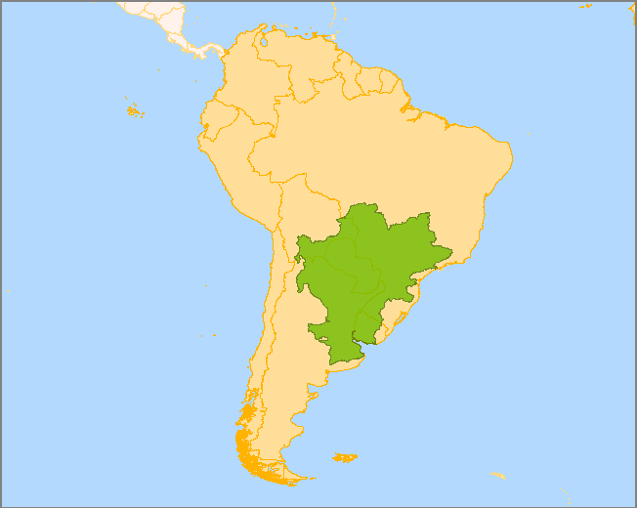
Enhanced understanding of land-atmosphere interactions in southeastern South America (SESA) can be applied to atmospheric prediction.
Focus on larger spatial scales
and longer time scales
La Plata River Basin (LPRB)
Source: FAO
National Research Council (2010)
Notes:
That leads us to another reason why we’re interested in studying land-atmosphere interactions in this region. We know that the land surface is an important source of predictability of the atmosphere on longer timescales. Based on the graphic shown here, we can see that soil moisture in particular can impart some atmospheric predictability on timescales ranging from 10 days to more than a year. Therefore, obtaining enhanced knowledge of the effect of soil moisture anomalies in this region means we can apply this increased understanding to improvements in atmospheric prediction on these longer timescales.

Slide 3
SM can have a positive or negative effect on precipitation.
Greater moisture availability
Positive Effect
Lower
moisture availability
Enhanced LH
Enhanced SH
Wet
Lower Bowen Ratio (BR)
Dry
Higher Bowen Ratio (BR)
Eltahir (1998); Pitman (2003)
Notes:
Before we go any further, let’s get some more details with respect to the physical mechanisms responsible in the positive and negative regimes of the soil moisture-atmosphere connection. Wet soils are associated with a lower BR, meaning that SH is diminished and LH is enhanced. In the case of a positive effect, enhanced LH associated with wet soils provides greater moisture availability, creating conditions which are favorable for the development of clouds and precipitation. Dry soils, on the other hand, are associated with a higher BR, meaning that LH is diminished and SH is enhanced. Diminished LH results in lower moisture availability, which creates conditions that are not favorable for the development of precipitation. So this is how we can expect wet or dry soils to affect precipitation in a positive regime.

Slide 4
SM can have a positive or negative effect on precipitation.
Negative Effect
Boundary layer destabilization
Enhanced evaporative cooling
Boundary layer stabilization
Enhanced surface heating
Enhanced LH
Enhanced SH
L
Thermal low
Wet
Lower Bowen Ratio (BR)
Dry
Higher Bowen Ratio (BR)
Cook et al. (2005); Hohenegger et al. (2009)
Notes:
In the case of negative relationship between soil moisture and precipitation, on the other hand, the enhanced LH associated with wet soils can also result in enhanced evaporative cooling, which results in stabilization of the boundary layer. That results in conditions which are not as conducive to the development of clouds and precipitation. In the case of dry soils, however, enhanced SH results in greater heating at the surface, which can lead to destabilization of the boundary layer and create conditions which are more favorable for the development of precipitation. Another important thing to note in the case of dry soils is that if enough heating occurs at the surface, a thermal low pressure area can develop which promotes convergence and rising air. Transport of moist air from other regions can also occur via a thermal low. So now we’ve summarized the ways in which soil moisture anomalies can positively and negatively affect precipitation anomalies at the local scale.

Slide 5
Science question: What is the relation between large-scale soil moisture anomalies and precipitation in SESA on the monthly timescale?
Notes:
Change to: what is the sign of the relation between sm and precip?

Slide 6
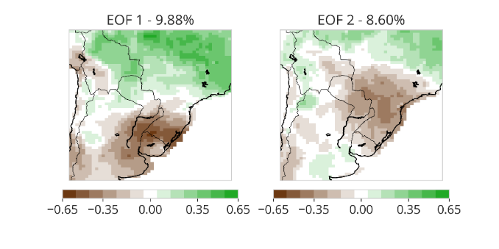
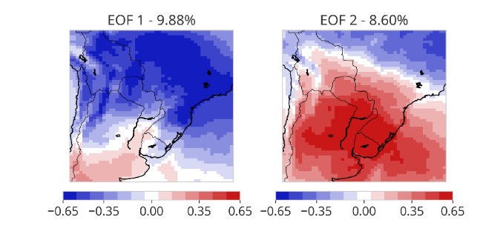
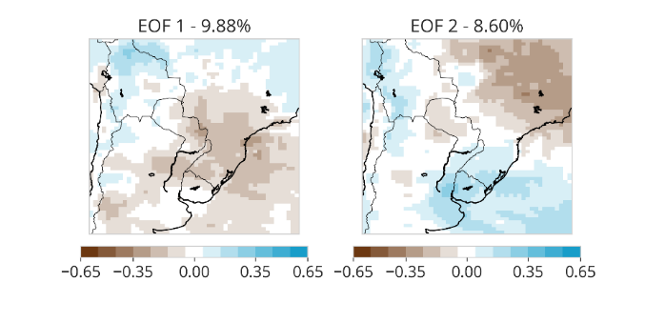

We employ statistical and modeling techniques to carry out this analysis.
Part I: Statistical approach
Empirical orthogonal function (EOF) analysis
Part II: Modeling approach
Community Earth System Model (CESM)

Slide 7
Part I: Statistical approach

Slide 8
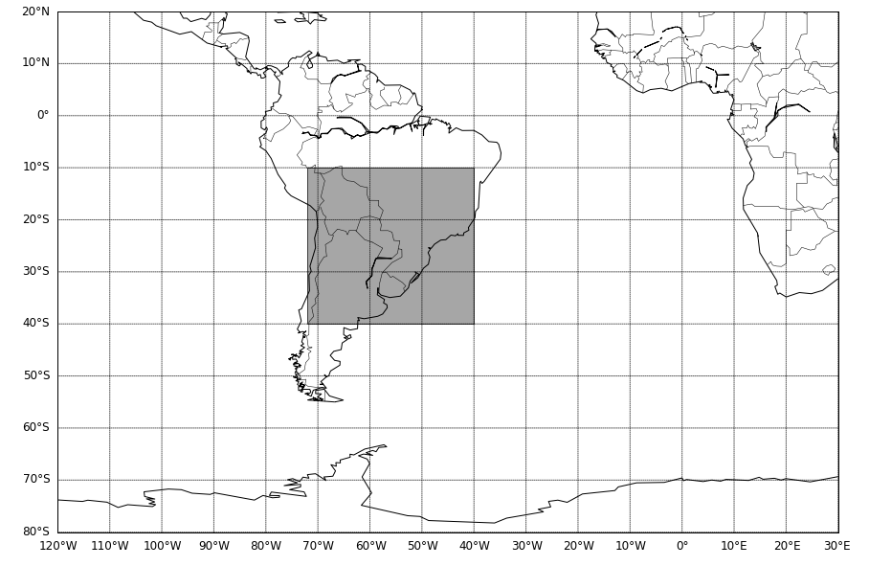
Multivariate EOF analysis is applied to 2-meter temperature (T2M), SM, and precipitation data at the monthly timescale.
Multivariate EOF
MERRA-2 data are used.
A one month lag is applied to the precipitation data.
Data for September – March are used.
No lag
Soil moisture
2-meter temperature
One month lag
Precipitation
Domain for EOF analysis
Part I: Statistical approach
Notes:
Say that we lag the precipitation to make sure we are looking at the effects of soil moisture on precip and not the other way around
MAKE SURE THIS IS REALLY CLEAR!

Slide 9



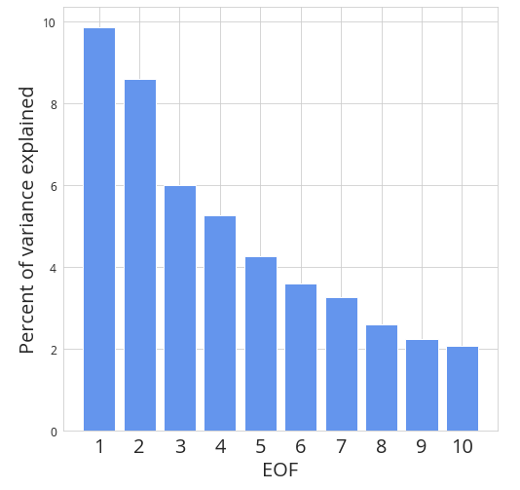
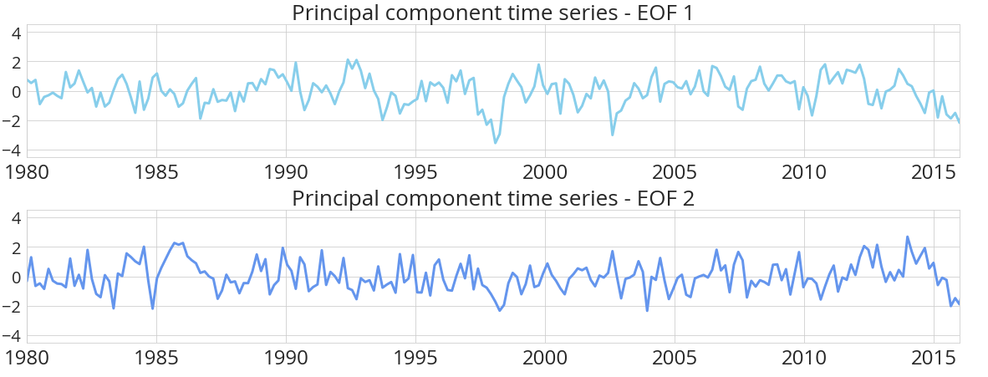
RESULTS OF EOF ANALYSIS MERRA-2
EOF 1 - 9.9%
Positive relationship:
Anomalously low (high) SM co-located with anomalously low (high) precipitation in the following month.
Soil moisture (No lag)
Temperature (No lag)
Precipitation (1 mo. lag)
Part I: Statistical approach
Notes:
Fonts bigger
Let’s take a look at some of the results from the EOF analysis using MERRA-2 data. EOF 1 is shown here; this mode accounts for 9.9% of the variability in the data. This mode is associated with a clear SM anomaly in this region (point out circled region) in southern La Plata. The T2M field indicates that some anomalous warming is present at the site of these SM anomalies, but there is also some inconsistency between the two fields in this EOF mode, indicating that the connection between these two variables may not be as strong. There is an area of decreased precipitation DURING THE NEXT MONTH co-located with the area of decreased soil moisture in this mode, supporting our assertion that this mode represents a positive relation between SM and precip DURING THE FOLLOWING MONTH. The principal component time series is shown below the EOFs, and from this time series we can get an idea of when in time these patterns are present. Finally, the bar chart to the right shows the variance explained by the first 10 EOFs in this analysis. We can see that the first two modes are well separated from the rest of the modes in terms of the variability they account for, which make these modes good candidates for our analysis.

Slide 10
RESULTS OF EOF ANALYSIS MERRA-2
EOF 2 – 8.60%
Negative relationship:
Anomalously low (high) SM co-located with anomalously high (low) precipitation in the following month.
Soil moisture (No lag)
Temperature (No lag)
Precipitation (1 mo. lag)
Part I: Statistical approach
Notes:
Fonts bigger
Next, we have EOF 2; this mode accounts for 8.6% of the variability in the data. This mode is associated with an SM anomaly (point out circled region) in central La Plata. The T2M field indicates that more obvious anomalous warming is present at the site of these SM anomalies, but there is also some inconsistency between the two fields in this EOF mode, indicating that the connection between these two variables may not be as strong. There is an area of decreased precipitation DURING THE NEXT MONTH co-located with the area of decreased soil moisture in this mode, supporting our assertion that this mode represents a positive relation between SM and precip DURING THE FOLLOWING MONTH. The principal component time series is shown below the EOFs, and from this time series we can get an idea of when in time these patterns are present. Finally, the bar chart to the right shows the variance explained by the first 20 EOFs in this analysis. We can see that the first two modes are well separated from the rest of the modes in terms of the variability they account for, which make these modes good candidates for our analysis.

Slide 11
Part II: Modeling approach

Slide 12
How do we use CESM to investigate the effect of large-scale SM anomalies on the atmosphere?
Sept-Nov
CONTROL SIMULATION
DRY SIMULATION
No imposed changes to precipitation in ATM model
No change to intercepted precipitation
Intercepted precipitation set to zero
No infiltration
Gradual drying
Part II: Modeling approach
Notes:
Explain that we impose the sm anomalies and analyze the model fields DURING THE TRANSITION from the dry to wet season
**IMPERVIOUS SURFACE**
Emphasize that the only thing changing in dry simulation is soil moisture
NO CHANGE TO THE ATMOSPHERE
Make this animated

Slide 13
How do we use CESM to investigate the effect of large-scale SM anomalies on the atmosphere?
Other specifications:
FHIST component set – active land and atmosphere components
Satellite phenology used in land model
0.9 x 1.25 degree spatial resolution (f09_g17)
25 year simulations
Part II: Modeling approach
Notes:
Explain that we impose the sm anomalies and analyze the model fields DURING THE TRANSITION from the dry to wet season
**IMPERVIOUS SURFACE**
Emphasize that the only thing changing in dry simulation is soil moisture
NO CHANGE TO THE ATMOSPHERE
Make this animated

Slide 14
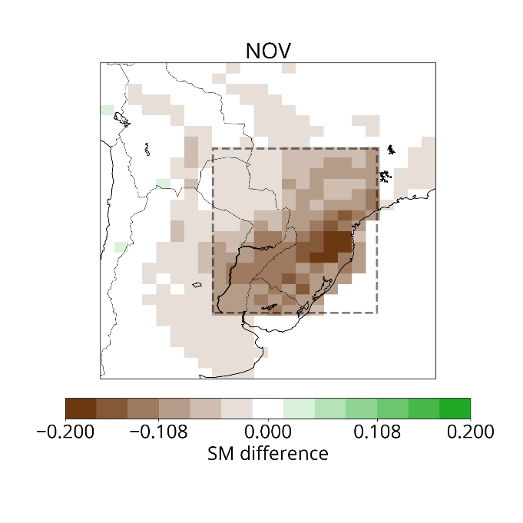
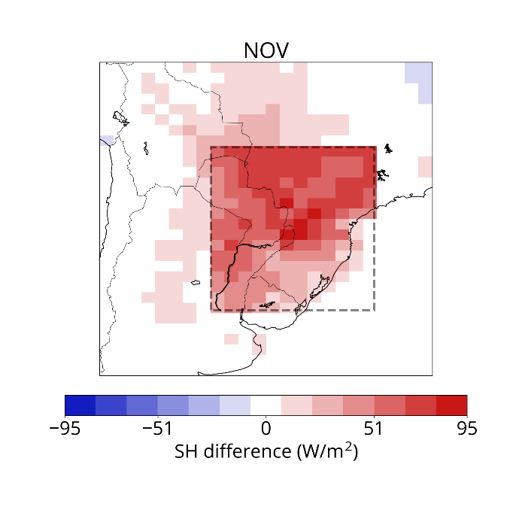
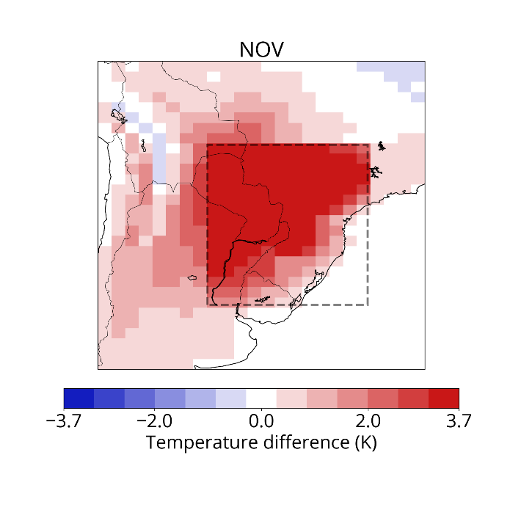
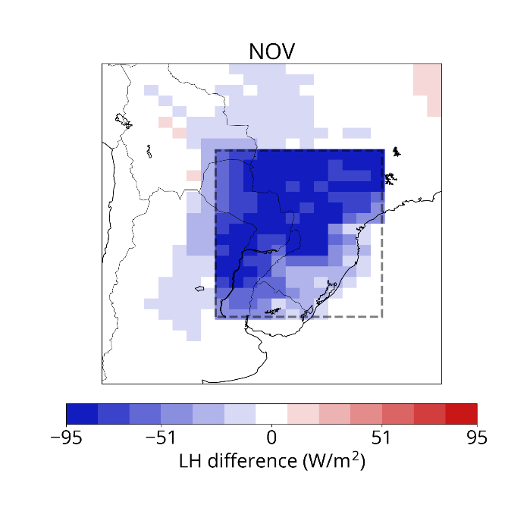
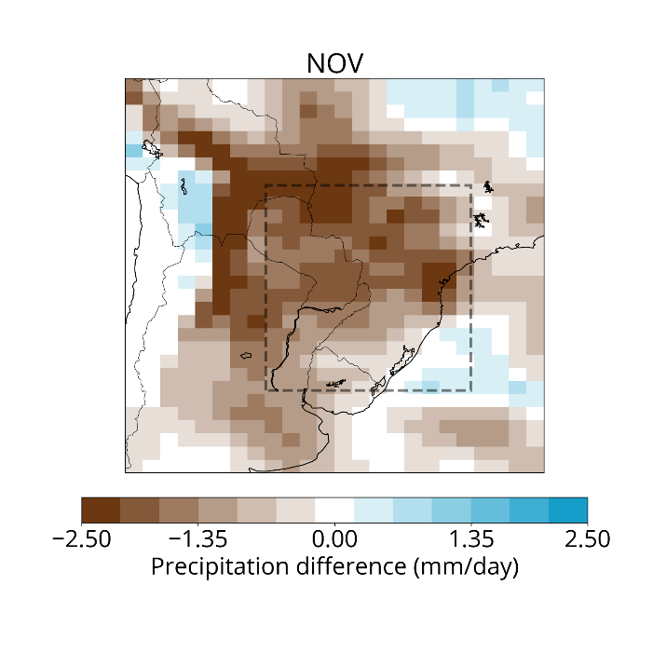
RESULTS OF CESM SIMULATIONS
DRY minus CONTROL – (MODEL) NOV
Soil moisture
Sensible heat flux
2-meter temperature
Decrease
Increase
Increase
Latent heat flux
Precipitation
Decrease
Decrease
Point at which SM anomalies are maximized in the model
Part II: Modeling approach
Notes:
Add percent decrease
Bigger labels on colorbars

Slide 15
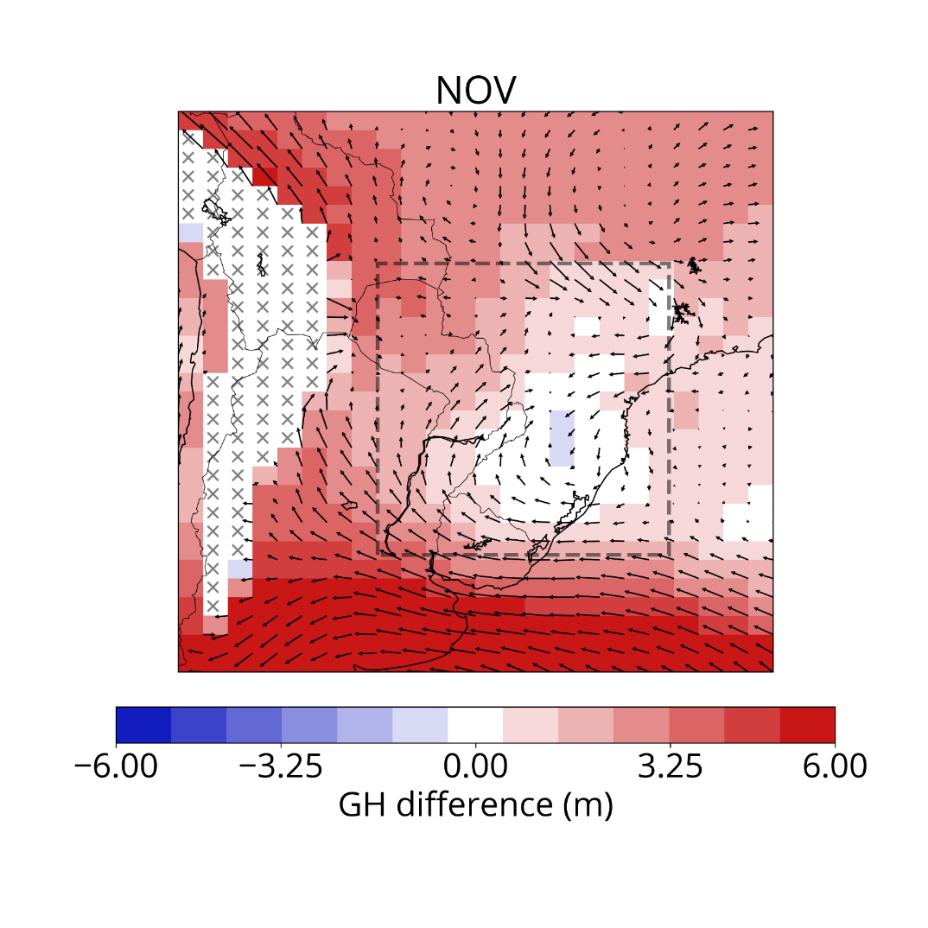
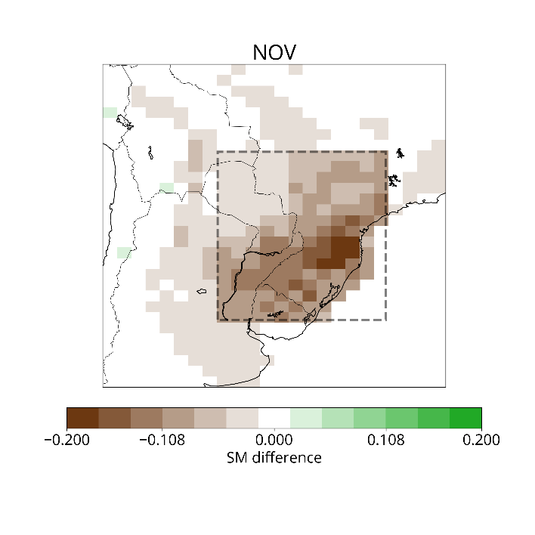
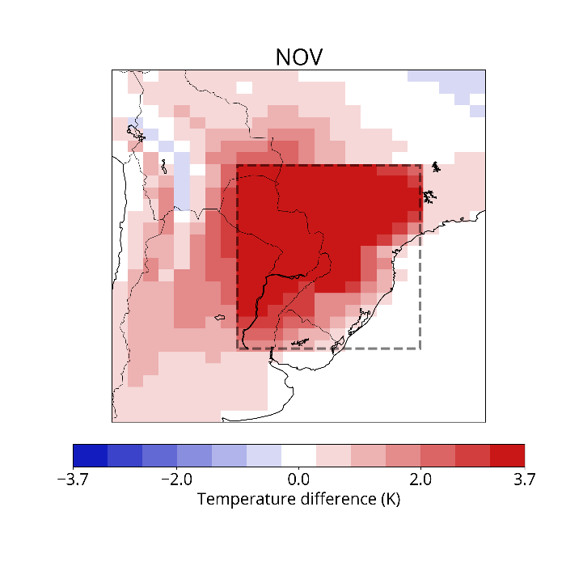
We also see changes in regional circulation, most likely a thermal low.
RESULTS OF CESM SIMULATIONS
DRY minus CONTROL – (MODEL) NOV
850 mb geopotential height and winds
Soil moisture
2-meter temperature
Part II: Modeling approach
Notes:
Add one big arrow
Box on GH plot not that clear

Slide 16
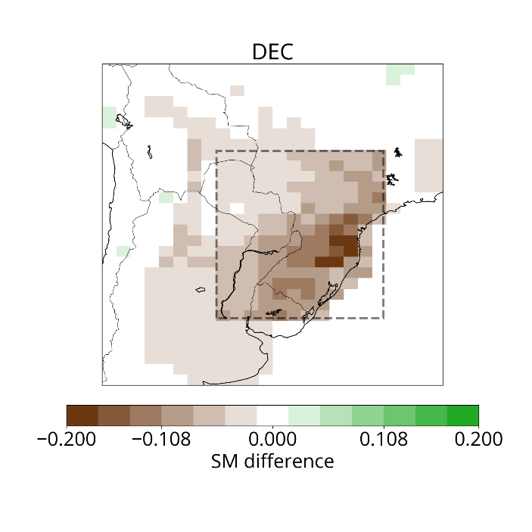
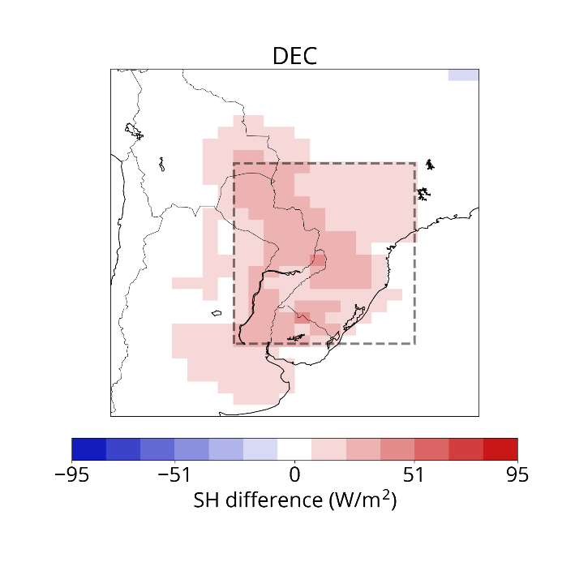
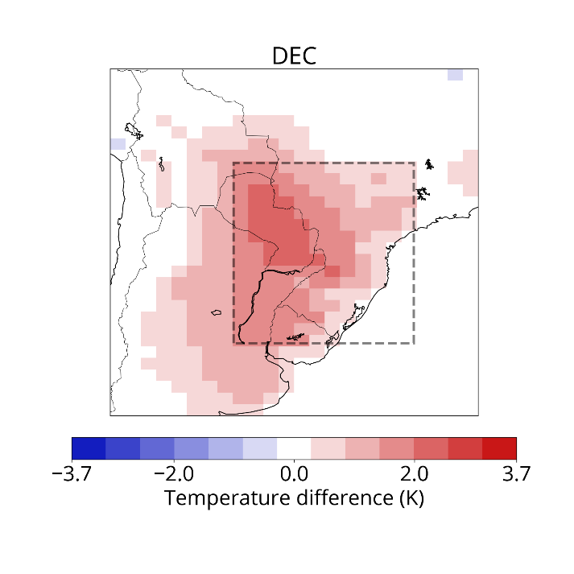
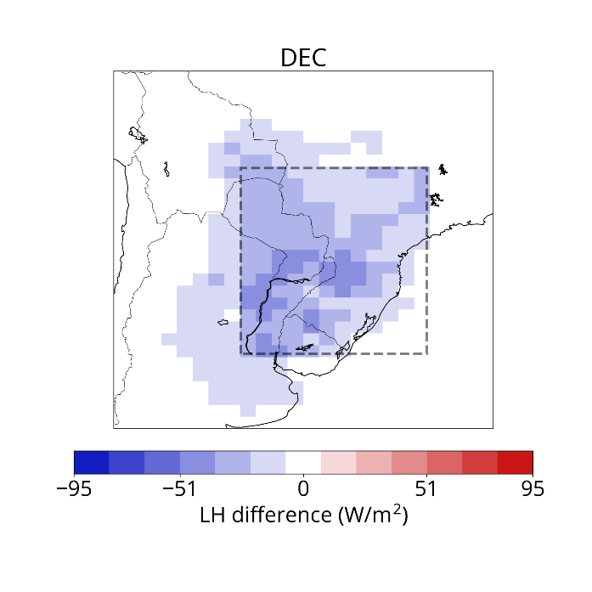
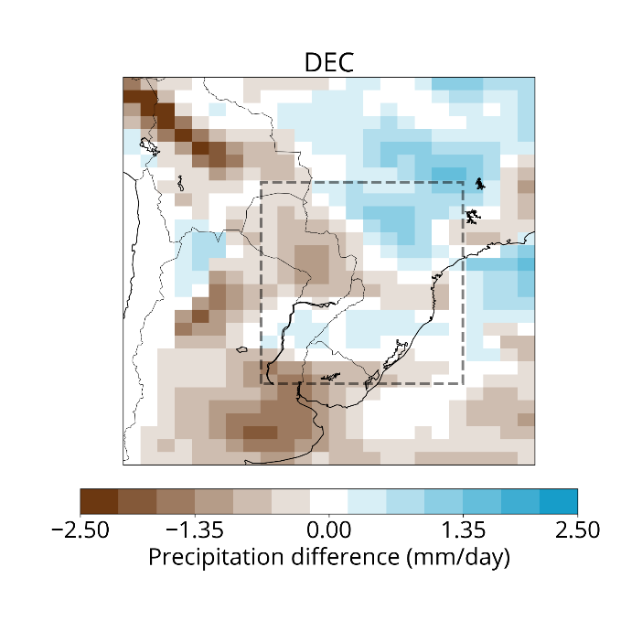
RESULTS OF CESM SIMULATIONS
DRY minus CONTROL – (MODEL) DEC
Soil moisture
Sensible heat flux
2-meter temperature
Decrease
Increase
Increase
Latent heat flux
Precipitation
Decrease
Month after SM anomalies are maximized in the model
Increase in South Atlantic Convergence Zone (SACZ) region
Increase in precipitation consistent with EOF 2
Part II: Modeling approach
Notes:
Smaller circle represents eof 2 and where moisture inflow is

Slide 17
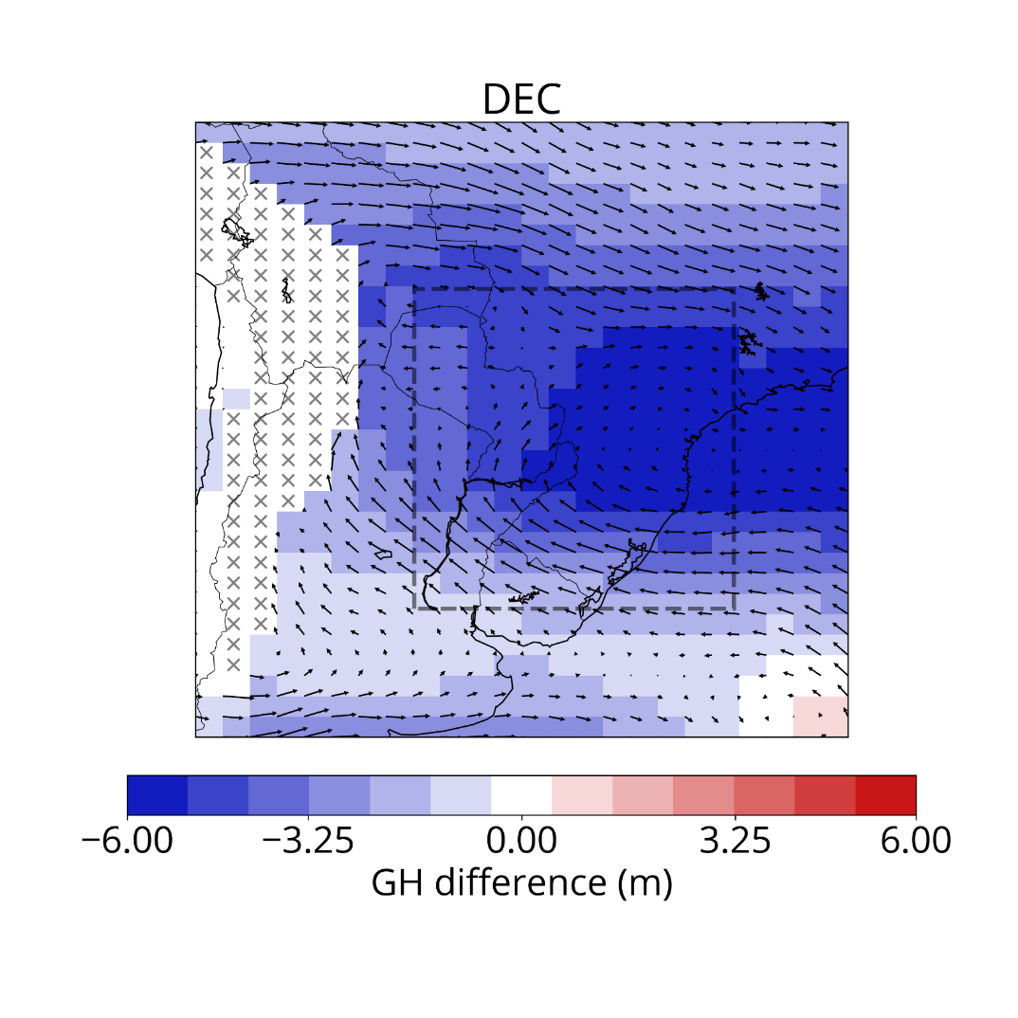

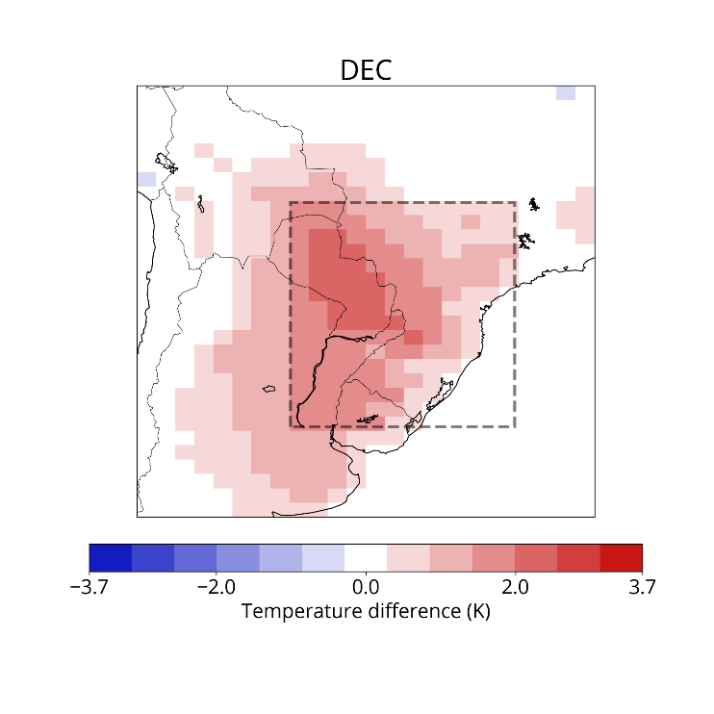
Cyclonic circulation anomalies are more apparent during December.
RESULTS OF CESM SIMULATIONS
DRY minus CONTROL – (MODEL) DEC
850 mb geopotential height and winds
Soil moisture
2-meter temperature
Part II: Modeling approach
Notes:
Add one big arrow
Box on GH plot not that clear

Slide 18
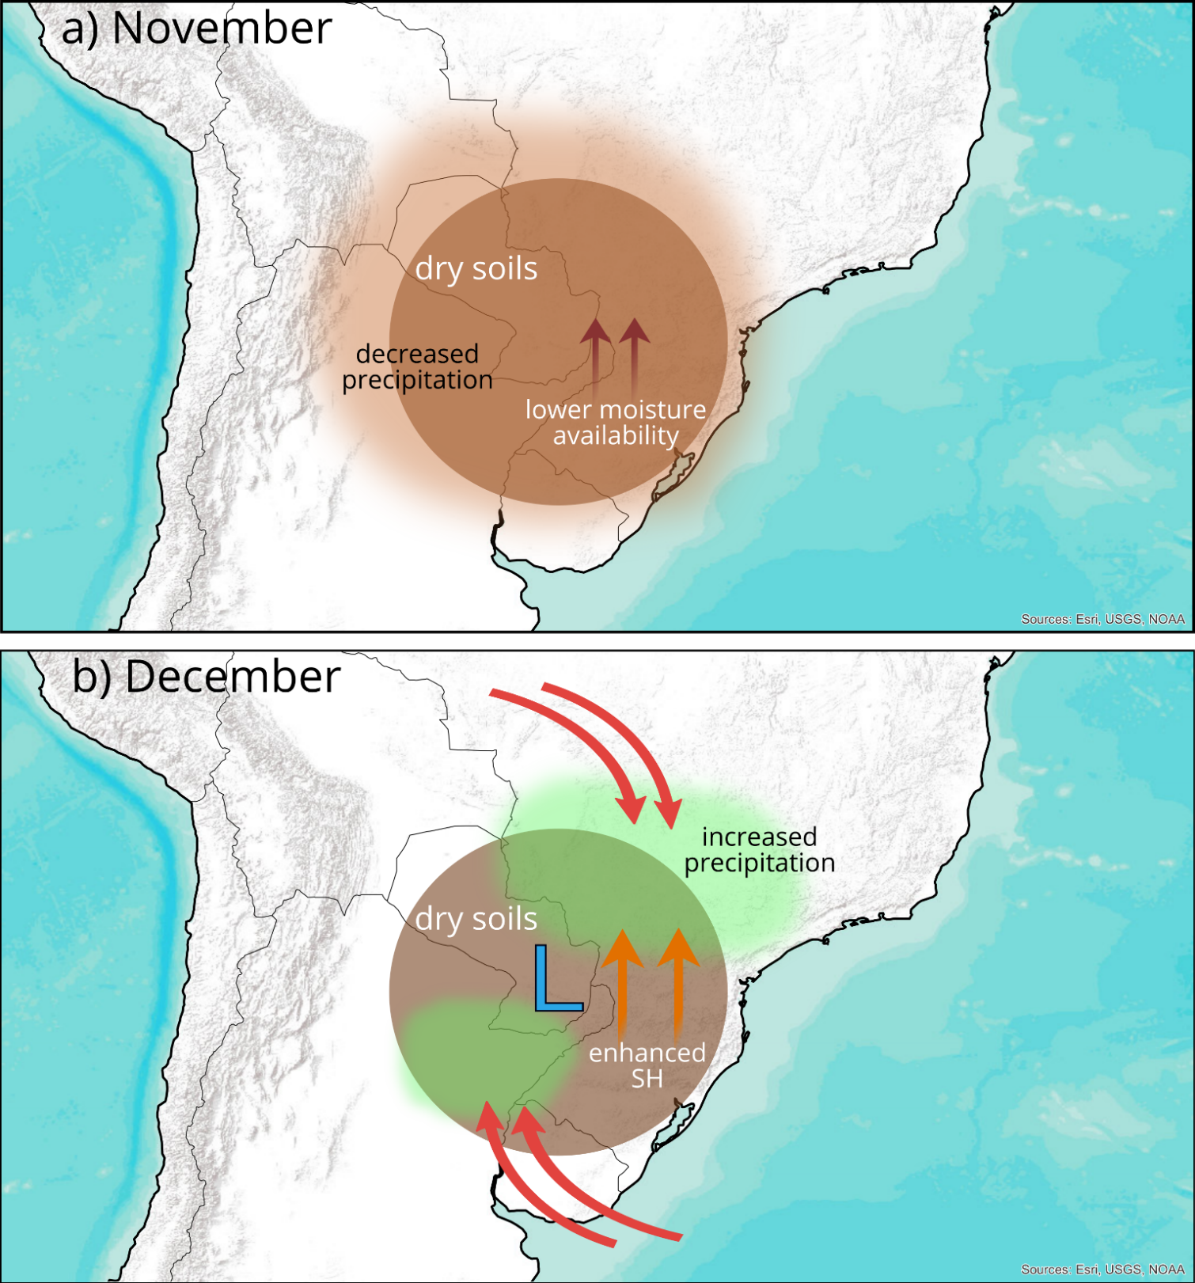
The positive relation between SM and precipitation dominates when SM anomalies are maximized.
Decreased recycling
Notes:
Change fonts on figure

Slide 19
A negative relation between SM and precipitation emerges in the month after maximum SM anomalies.
Thermal low
Notes:
Moisture sources
Heating

Slide 20
References
Cook, B., Bonan, G., & Levis, S. (2006). Soil moisture feedbacks to precipitation in Southern Africa. Journal of Climate, 19(17), 4198-4206.
Eltahir, E. (1998). A soil moisture-rainfall feedback mechanism 1. Theory and observations. Water Resources Research, 34(4), doi:10.1029/97WR03499.
Hohenegger, C., Brockhaus, P., Bretherton, C.S. & Schär, C. (2009): The Soil Moisture–Precipitation Feedback in Simulations with Explicit and Parameterized Convection. J. Climate, 22, 5003–5020, doi:10.1175/2009JCLI2604.1.
National Research Council. (2010). Assessment of Intraseasonal to Interannual Climate Prediction and Predictability. Washington, DC: The National Academies Press. doi: doi.org/10.17226/12878.
Pitman, A. (2003). The evolution of, and revolution in, land surface schemes designed for climate models. International Journal of Climatology, 23(5), 479-510.
Taylor, C., Gounou, A., Guichard, F., Harris, P., Ellis, R., Couvreux, F., & De Kauwe, M. (2011). Frequency of Sahelian storm initiation enhanced over mesoscale soil-moisture patterns. Nature Geoscience, 4(7), 430-433.

Slide 21
Acknowledgements
Liang Chen (Illinois State Water Survey), who helped with the modeling portion of this study.
UIUC Sloan University Center for Exemplary Mentoring & NCAR Advanced Study Program for their support.
High performance computing support from Cheyenne (doi:10.5065/D6RX99HX) provided by NCAR's Computational and Information Systems Laboratory (CISL), sponsored by the National Science Foundation.
This material is based upon work supported by the National Science Foundation under Grant No. 1454089.

Slide 22

Thank you!
Questions?
Carolina Bieri
University of Illinois at Urbana-Champaign
bieri2@illinois.edu
Notes:
Moisture sources
Heating

